Slide 1

ENERGY
How did you use energy today?

Slide 2
Today’s Learning Goals:
Explore terms related to:
states of energy
forms of energy
basketball...

Slide 3
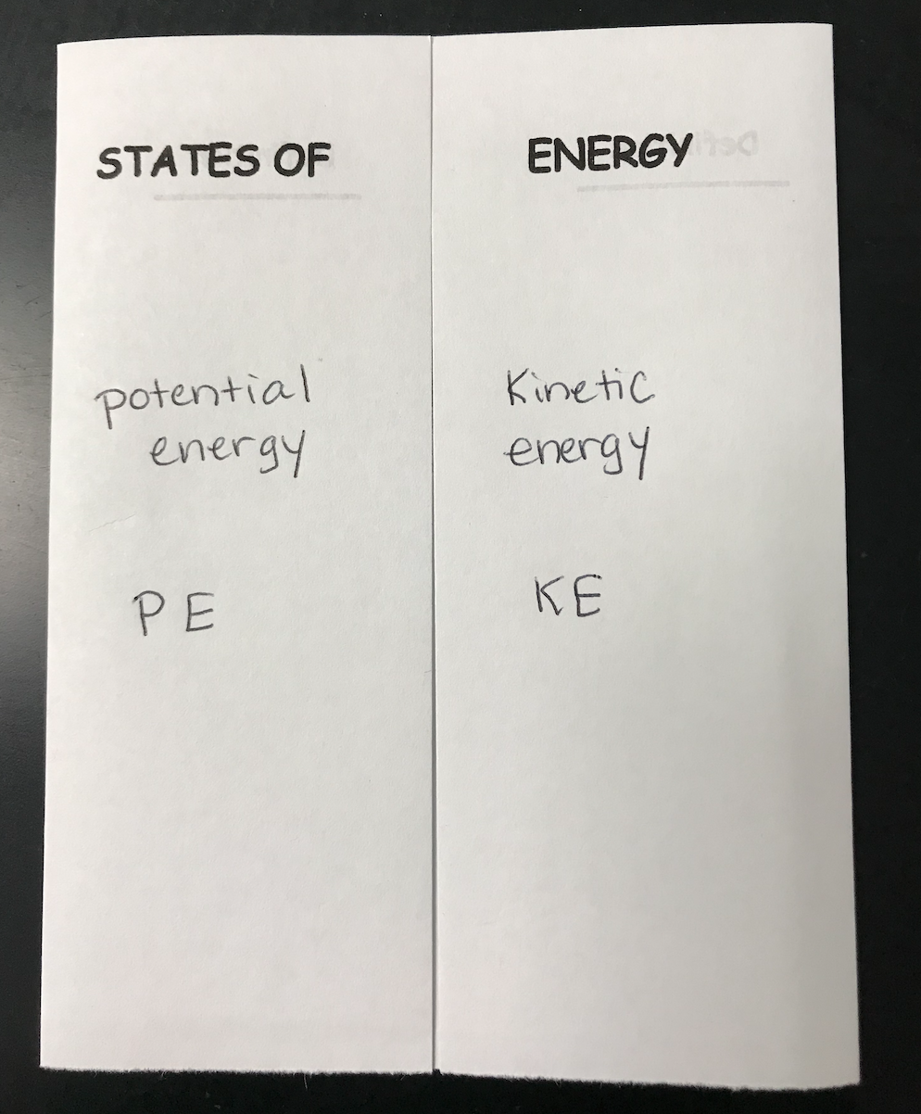
Baseball pitcher...

Slide 4
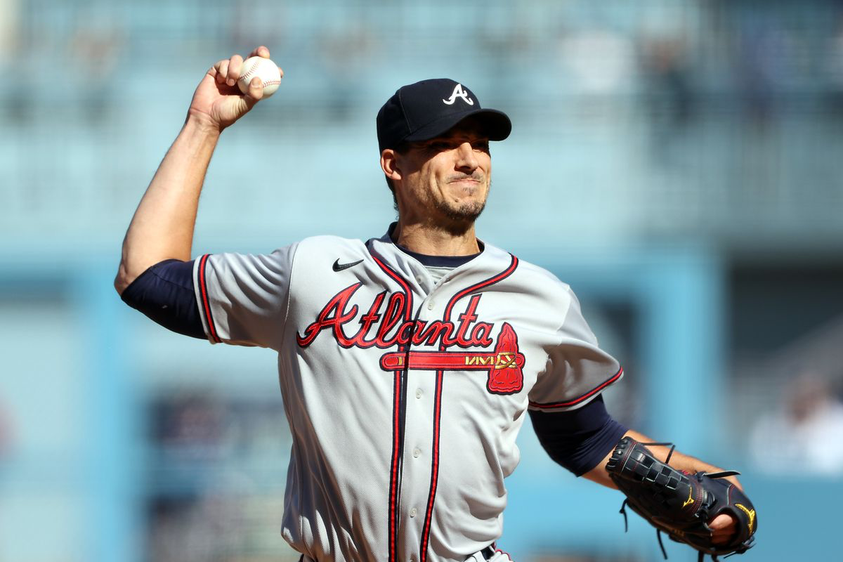
World Series Game 1 Starting Braves pitcher Charlie Morton...

Slide 5
Potential Energy
Energy because of object’s positon (stored)
PE = mgh
m= mass
g= gravity due to acceleration
h= height
PE

Slide 6
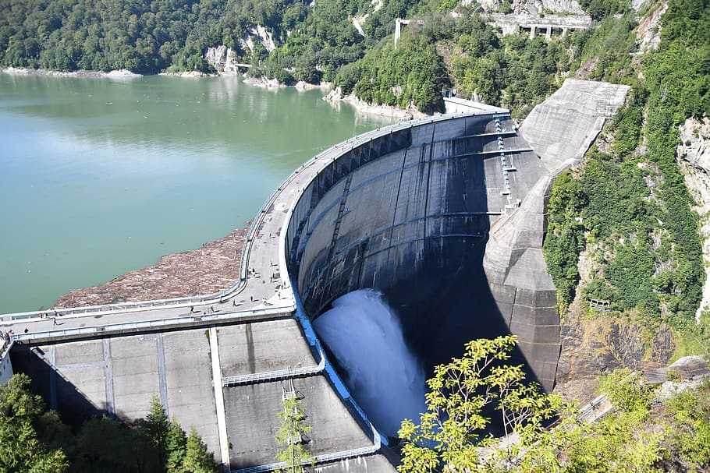
Potential energy
Rock at the top of a hill
Ball pitcher is holding right before he throws it
Water behind a dam
examples
Skateboard...

Slide 7
Kinetic Energy
Energy of motion
KE= ½mv²
m= mass in kg
v= velocity (speed) in m/s
KE

Slide 8
kinetic energy
walking/running
Skateboarding
Moving car
examples
Basketball...PE up then KE down...

Slide 9
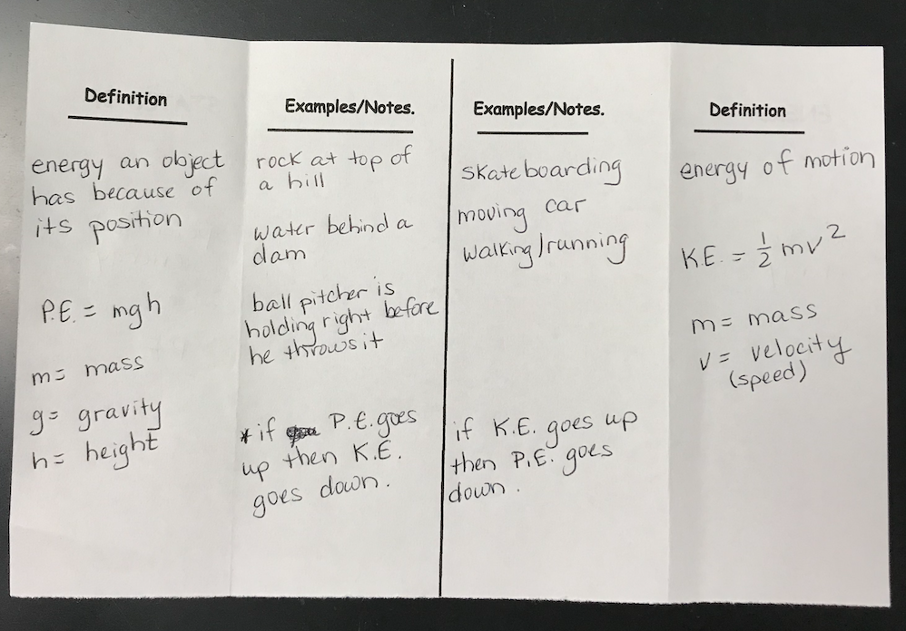

Slide 10
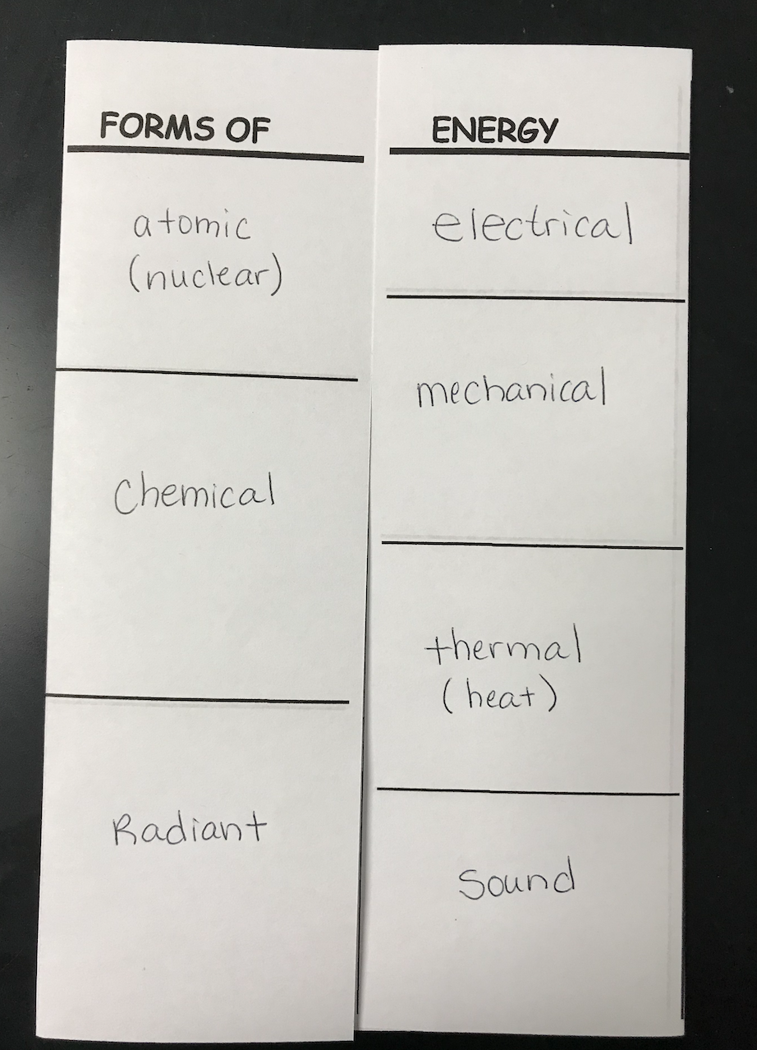

Slide 11
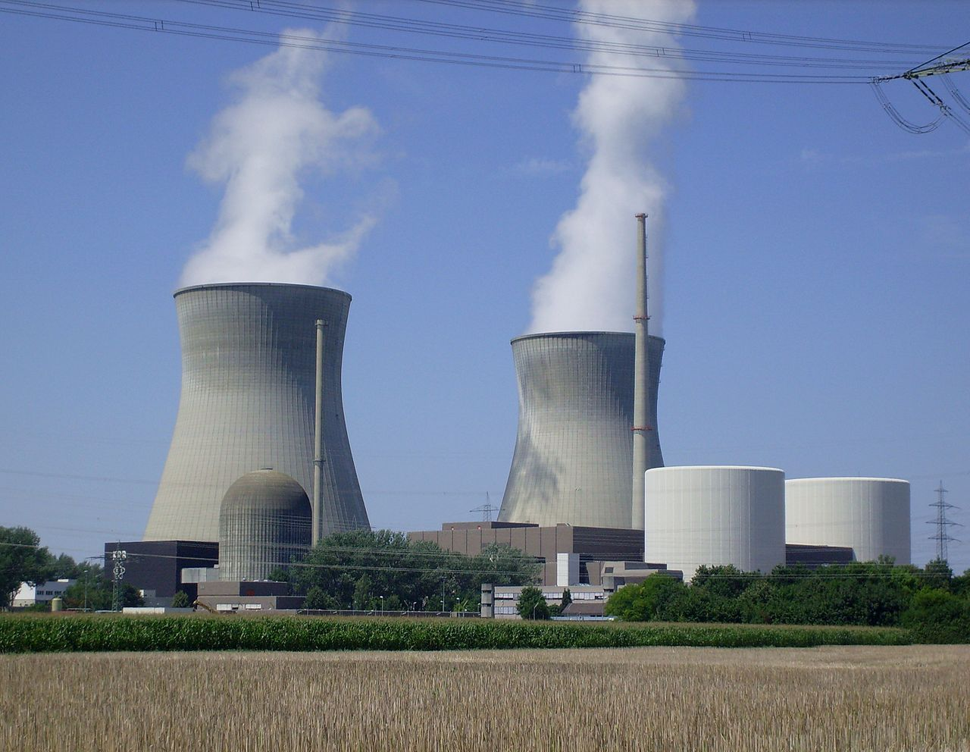
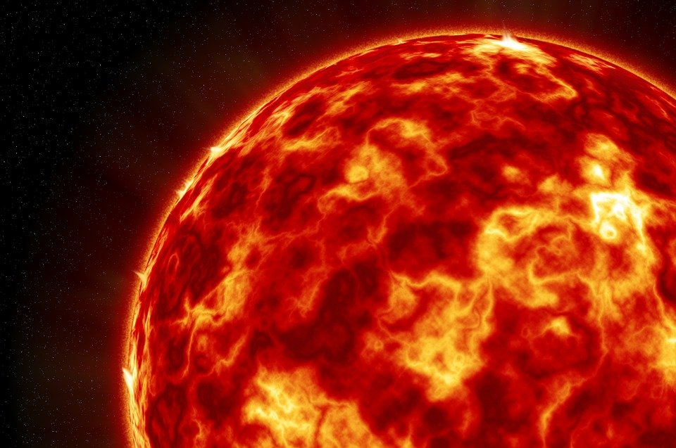

Slide 12
Atomic (Nuclear) Energy
EXAMPLES:
Energy given off by the sun (fusion: H nuclei join to form He; unstable)
Nuclear power plant (fission: nucleus of Uranium is split)
DEFINITION:
Energy from changes in the nucleus of an atom
STAND UP...

Slide 13
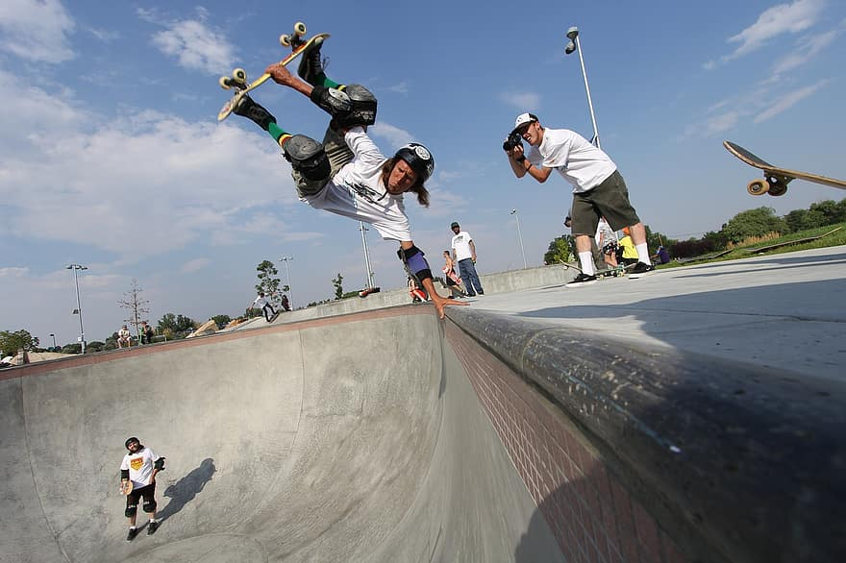
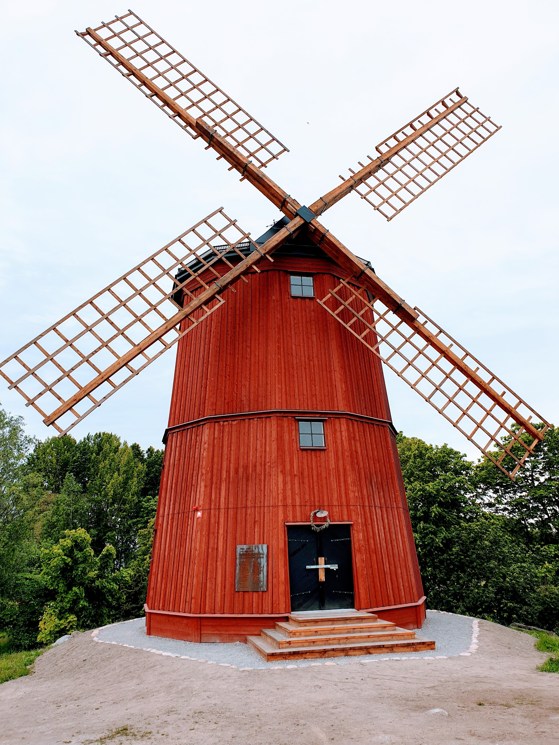

Mechanical energy
EXAMPLES:
DEFINITION:
Amount of work an object can do because of its total potential energy and kinetic energy
LIGHTS OFF...

Slide 14
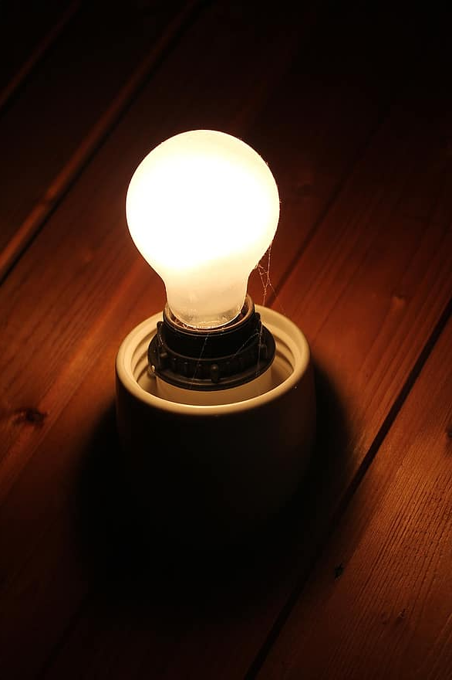
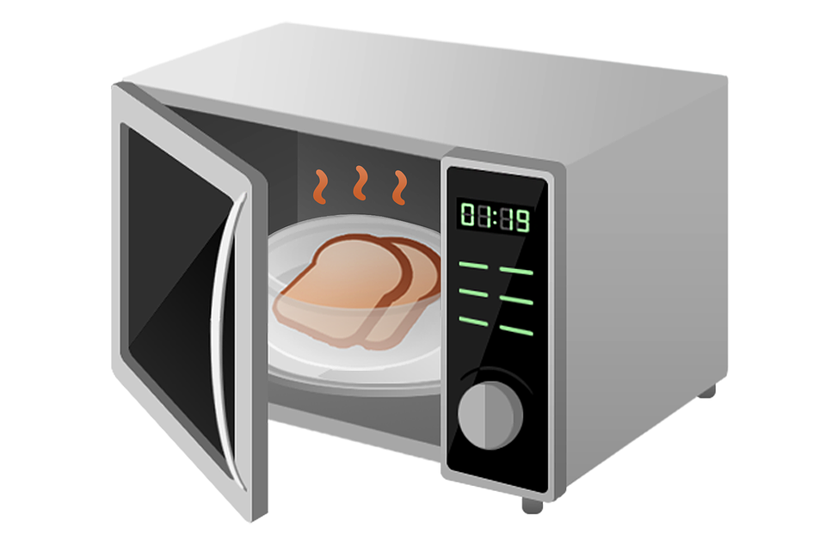

radiant Energy
EXAMPLES:
Visible light-
UV rays
DEFINITION:
Produced by vibrations of electrically charged particles
SONG...

Slide 15

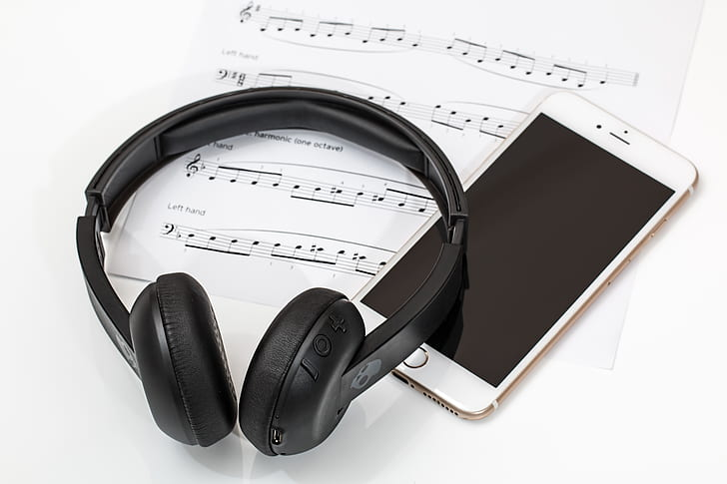
sound Energy
EXAMPLES:
DEFINITION:
Energy you can hear due to vibrations transmitting through the air
PLUG IN POP...

Slide 16
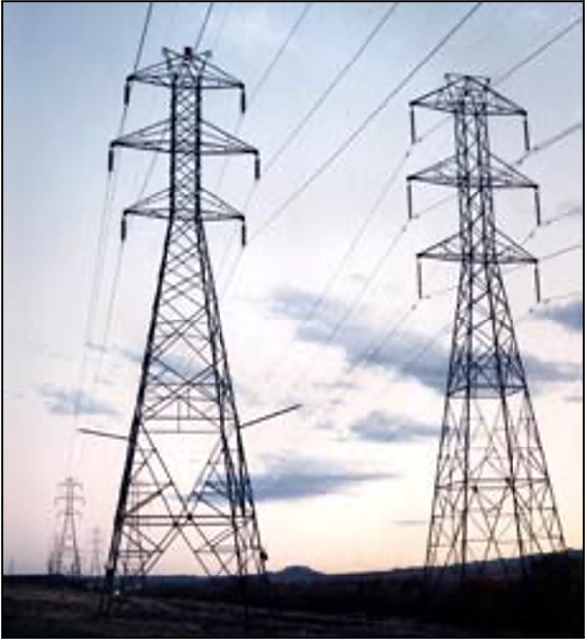
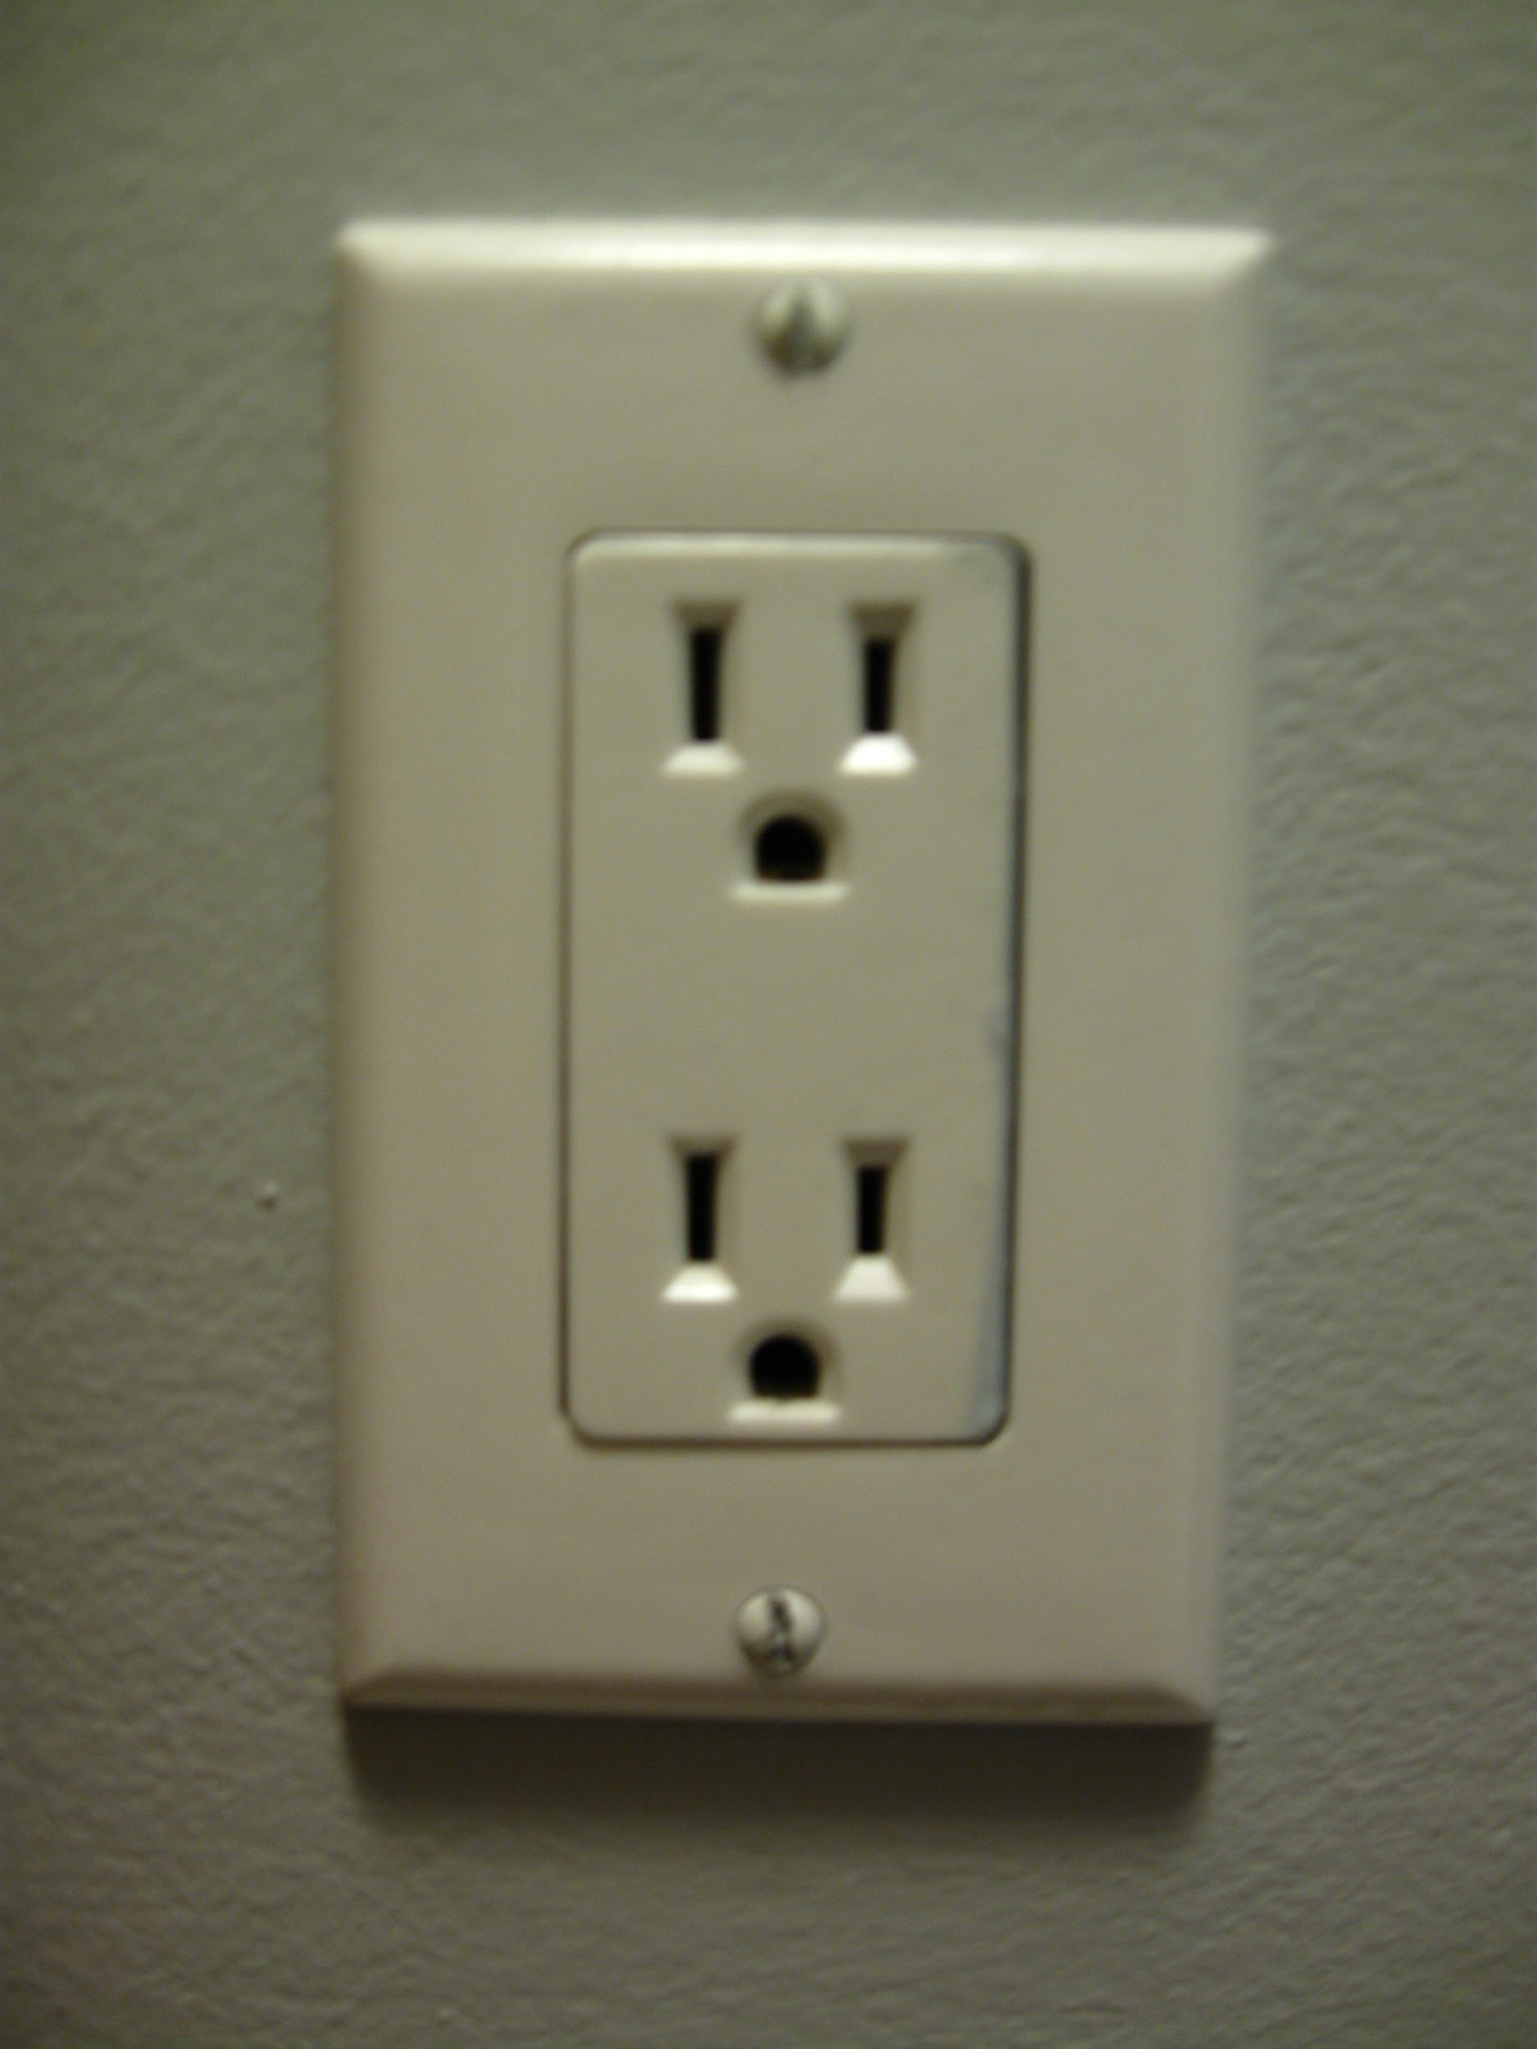
Electrical Energy
EXAMPLES:
DEFINITION:
Energy of moving electrons (electric current)

Slide 17

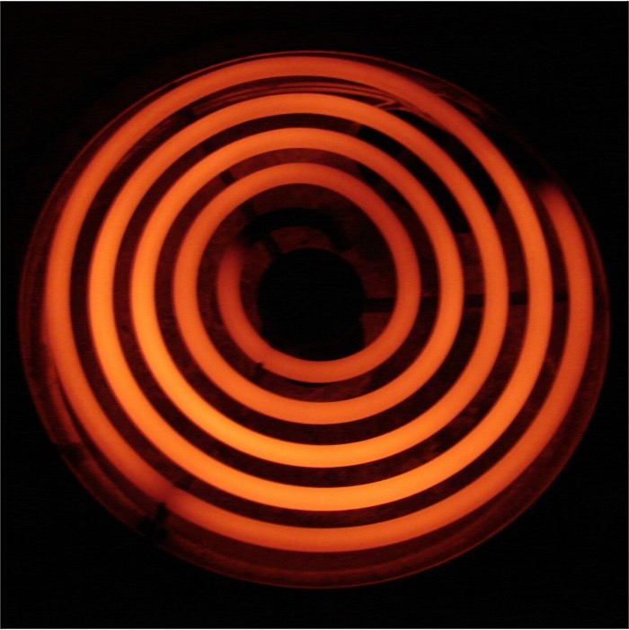
thermal Energy
EXAMPLES:
DEFINITION:
All the kinetic energy due to random movement of particles

Slide 18
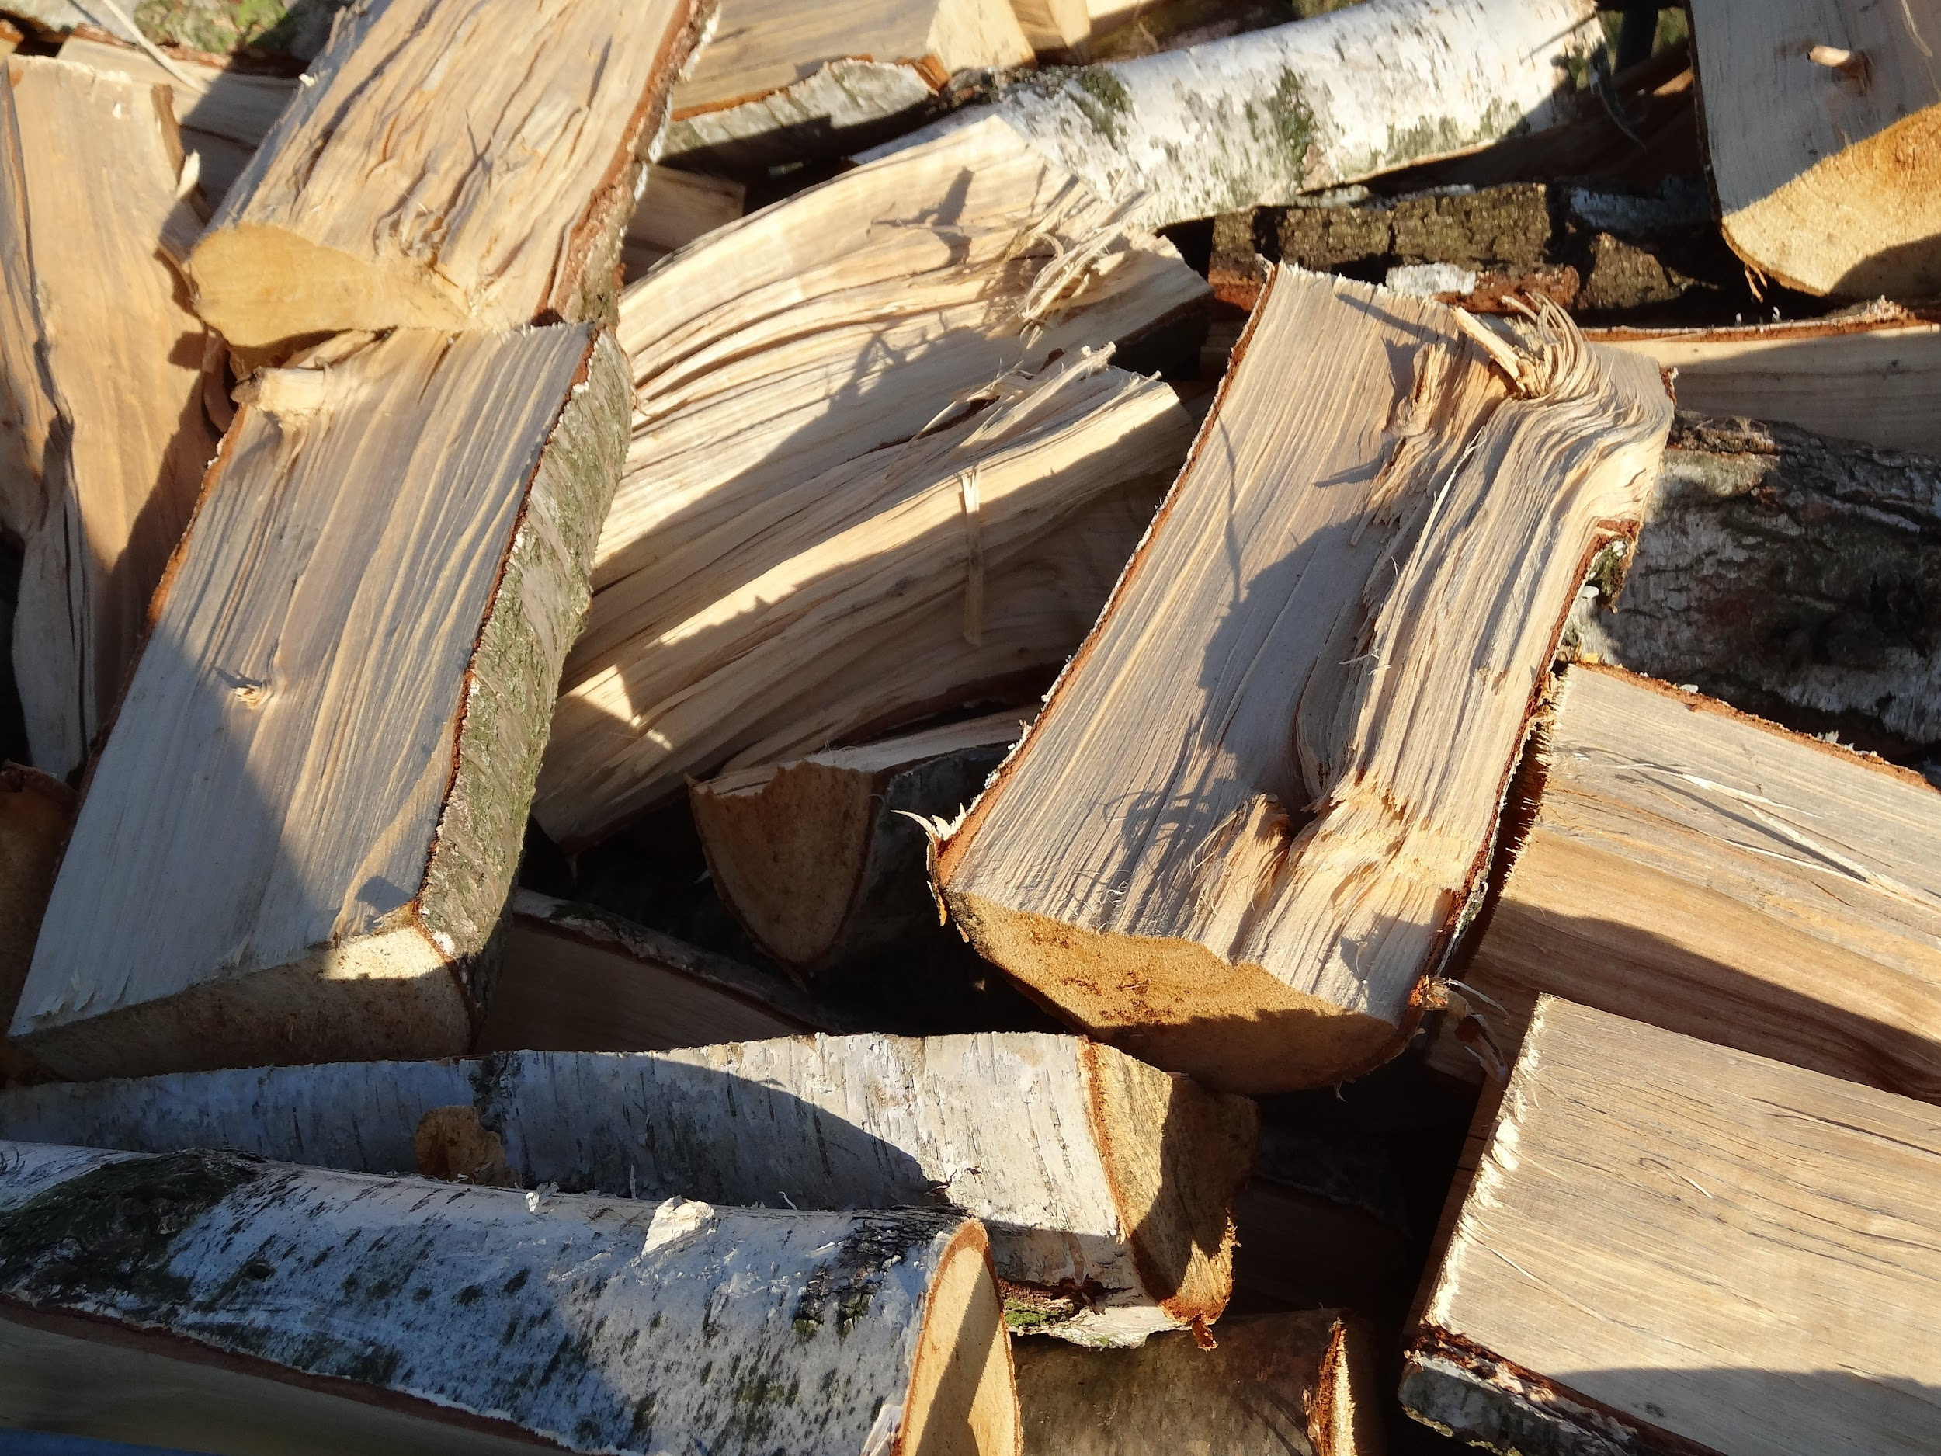
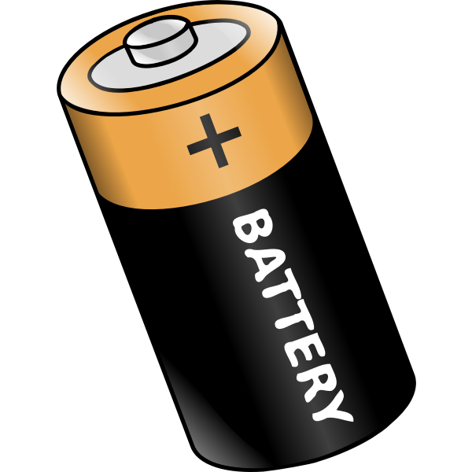
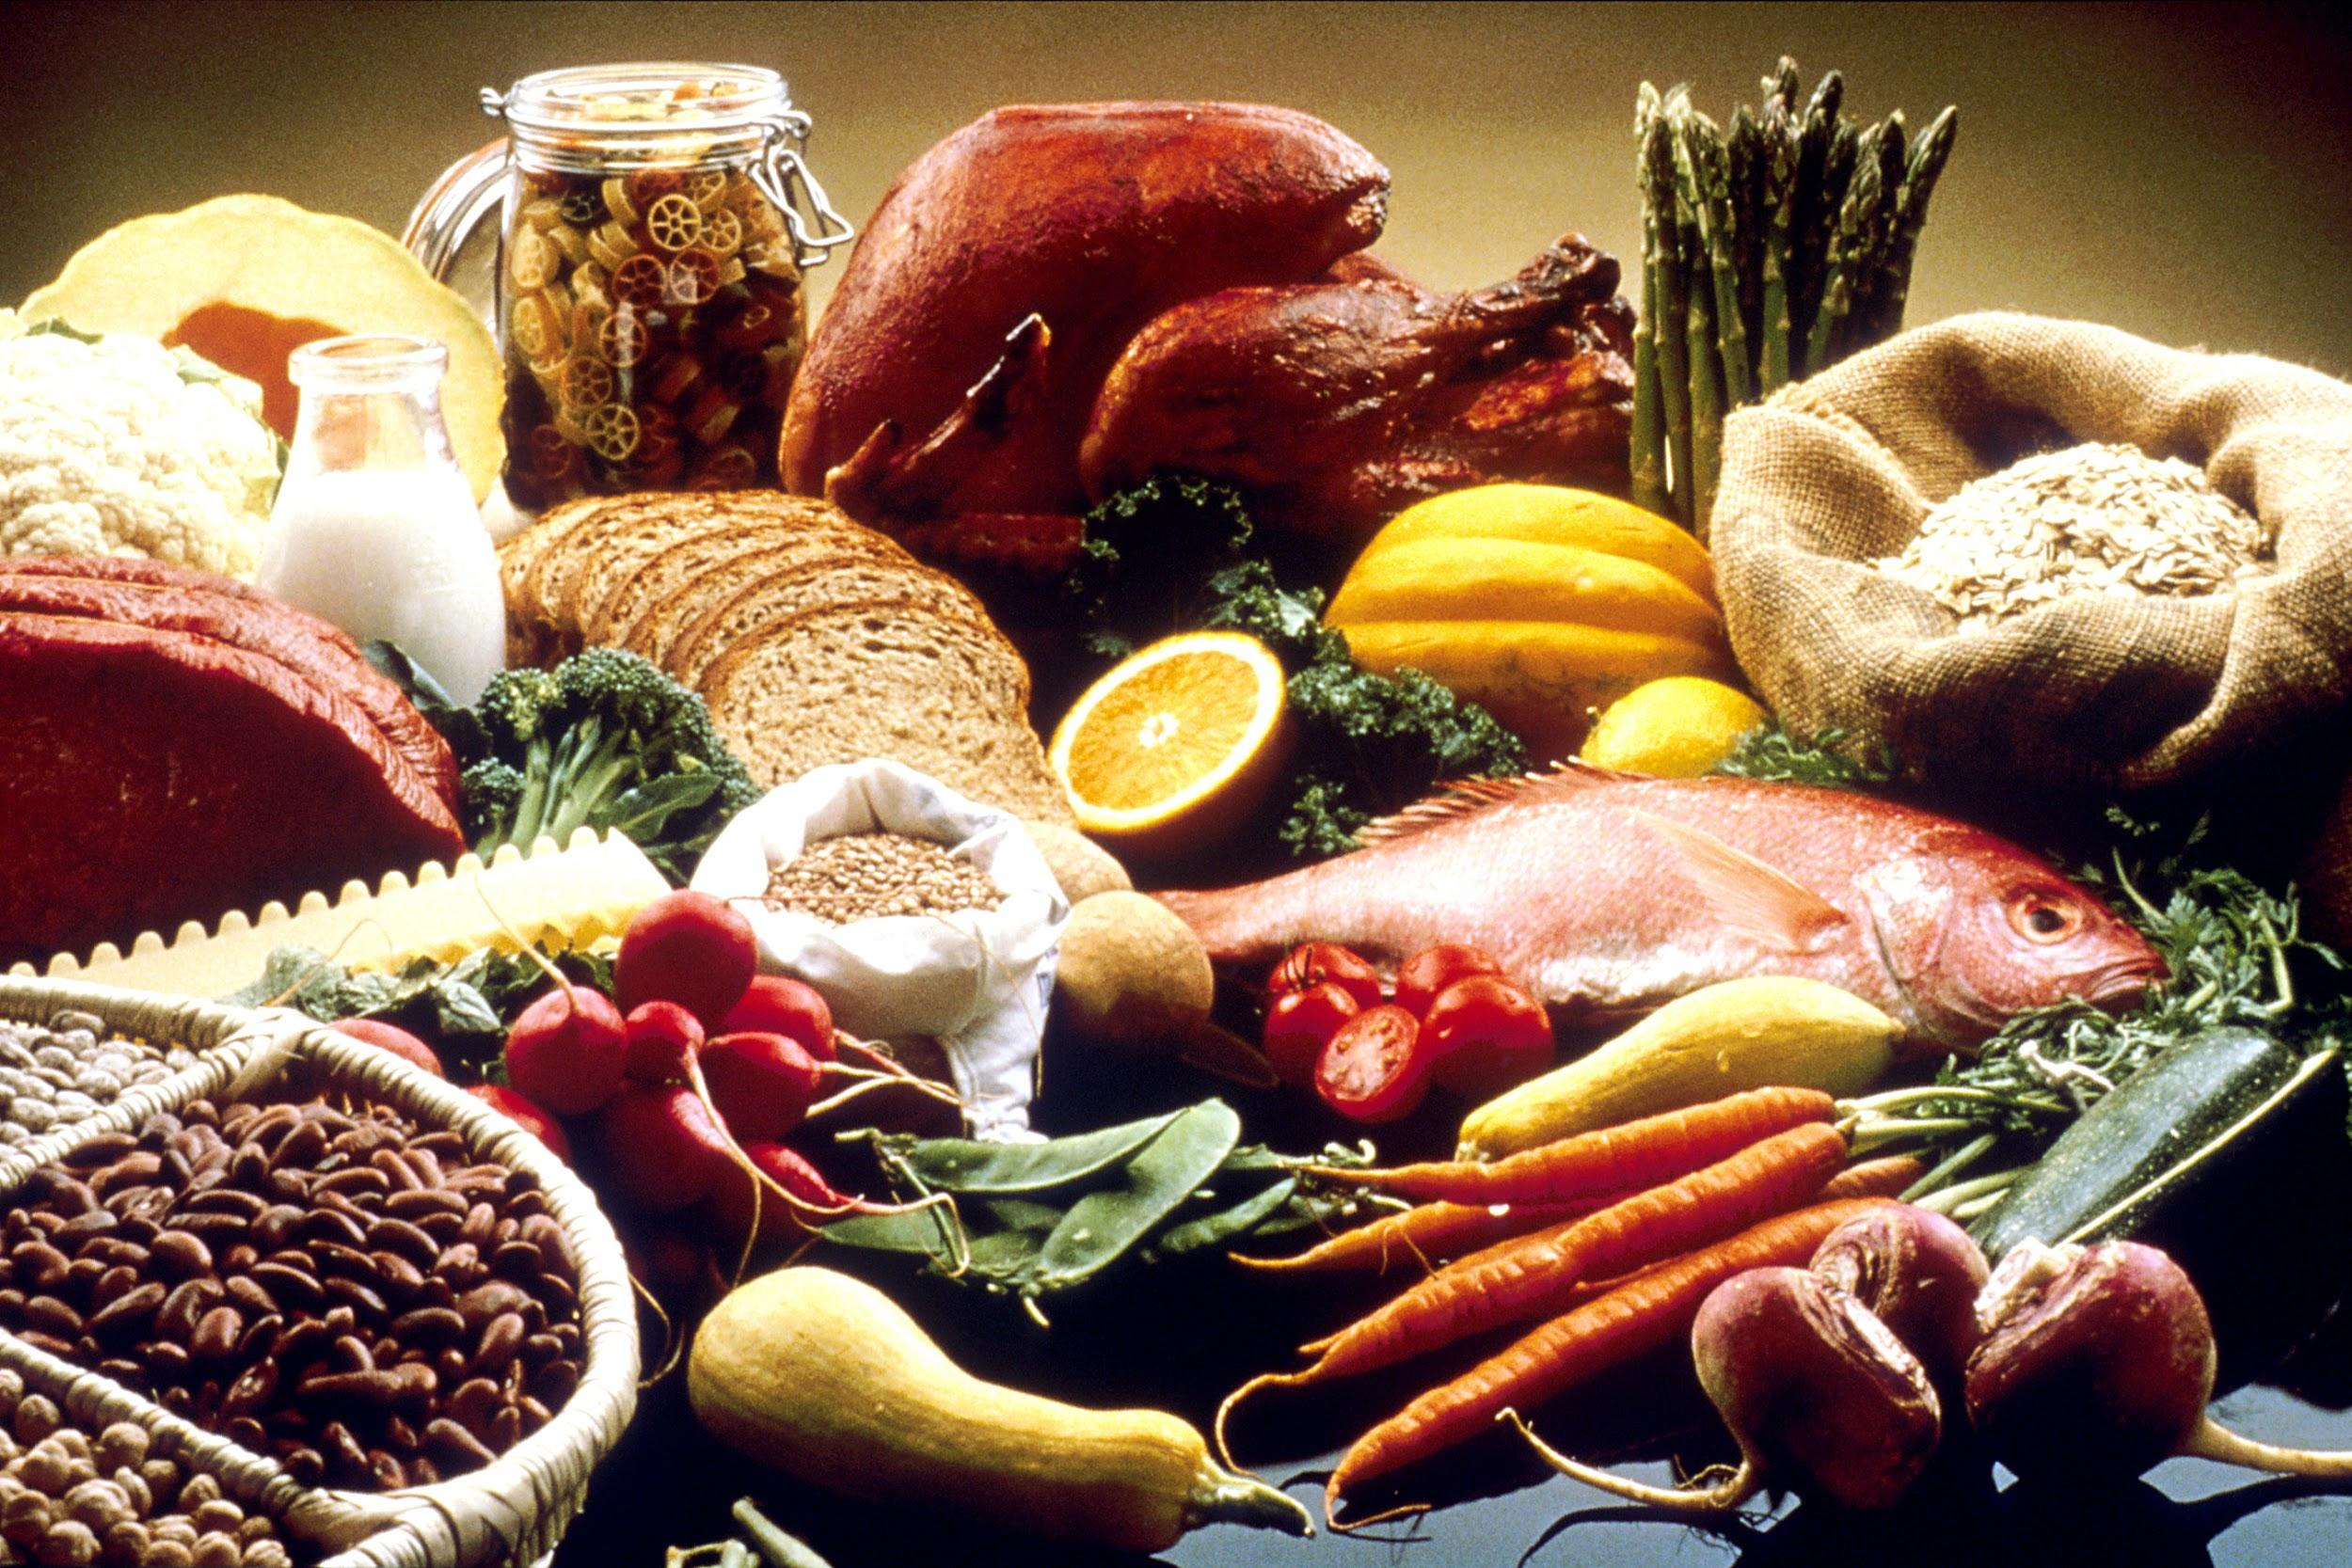
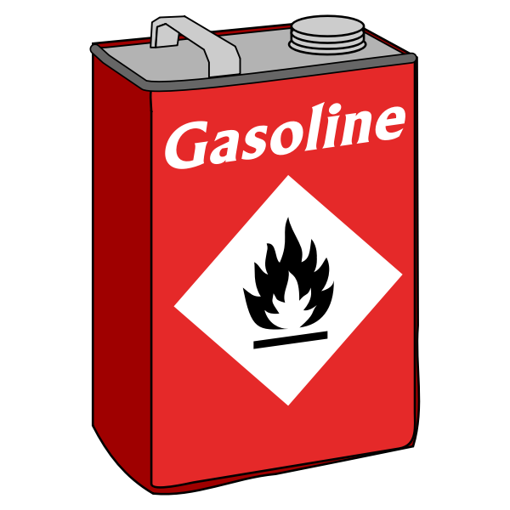
Chemical Energy
EXAMPLES:
DEFINITION:
Energy stored in chemical bonds and when bonds are broken (atoms rearrange) energy is released

Slide 19
