Slide 1

Potential & Kinetic Energy
How did you use energy today?

Slide 2
Learning Targets
illustrate the relationships of kinetic energy to mass and speed, and potential energy to mass and height of an object
Plan and carry out an investigation to explain the transformation between kinetic and potential energy within a system

Slide 3
Potential Energy?
kinetic Energy?
Measured in Joules (J)

Slide 4
4 types of Potential energy
: energy that is stored because of an object’s position or height above the earth’s surface
: energy stored within a push or a pull
: energy stored up in substances due to their chemical bonds
: energy of particles inside an atom
Who likes RCs?

Slide 5
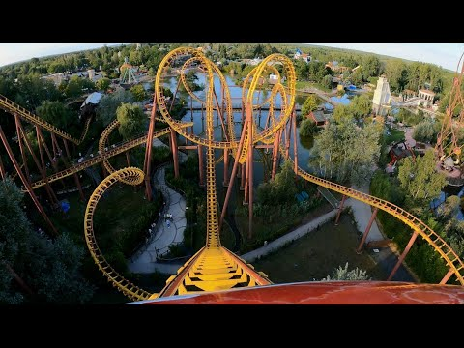
smiler...

Slide 6
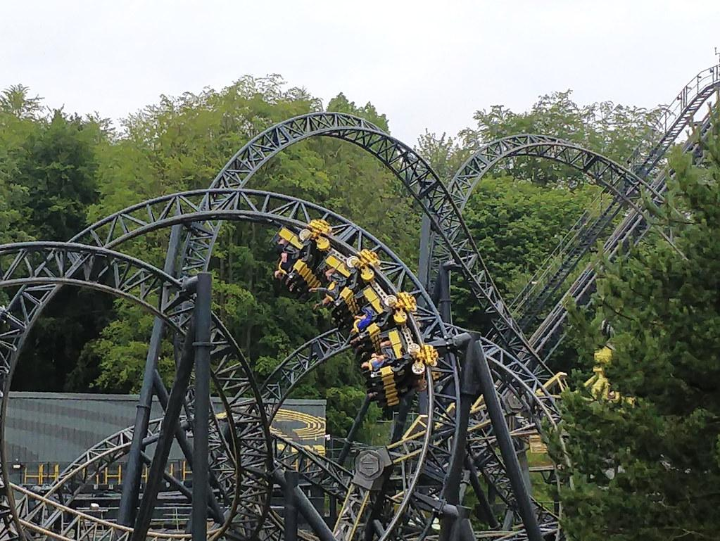

Slide 7
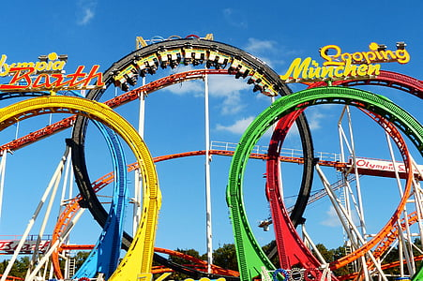
Let’s Make A Roller Coaster!

Slide 8
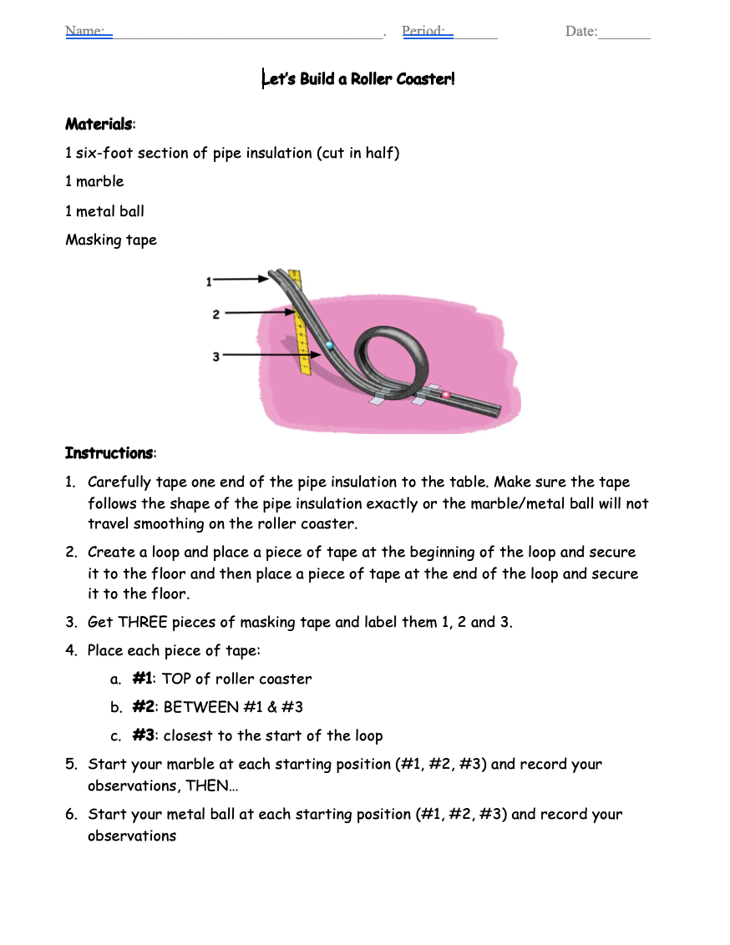
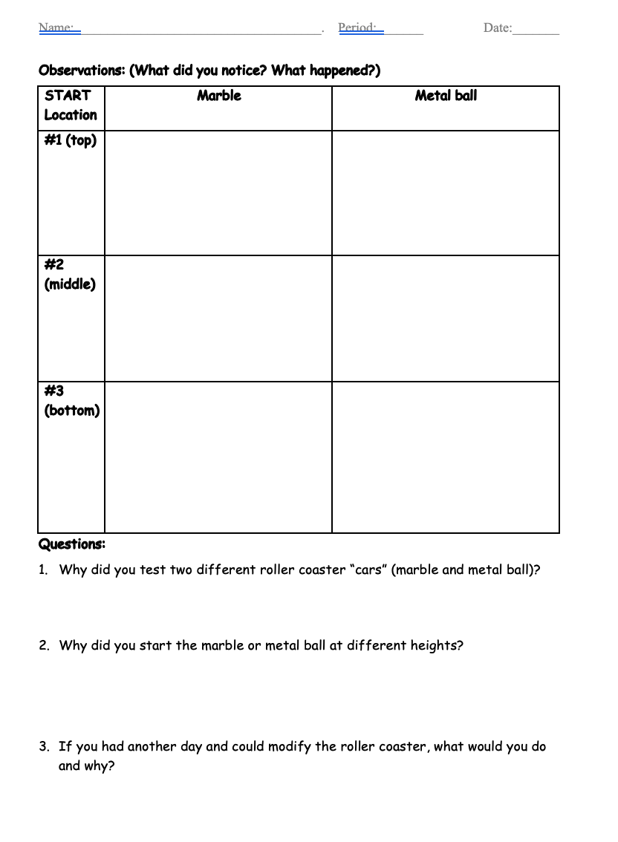

Slide 9
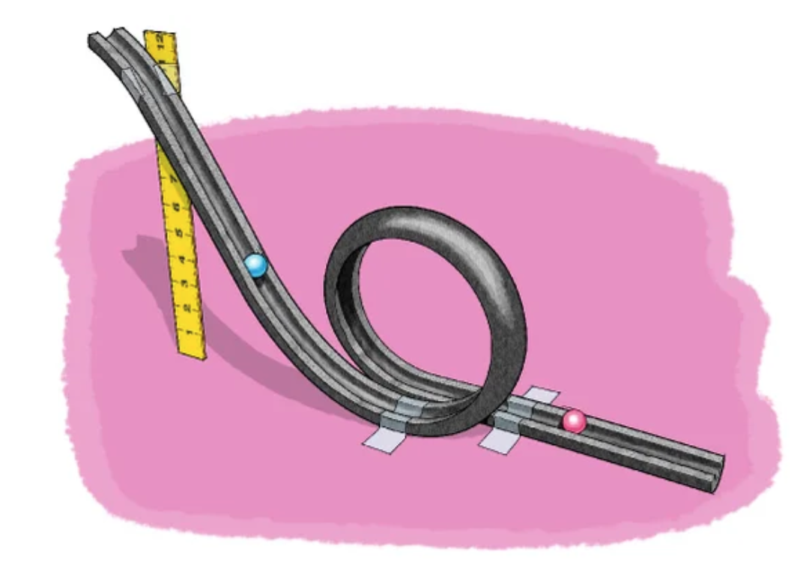

1
2
3
THINK:
Why are you testing a marble and then a metal ball?
Why are you starting your marble (and metal ball) at 3 different heights?

Slide 11
