Slide 1
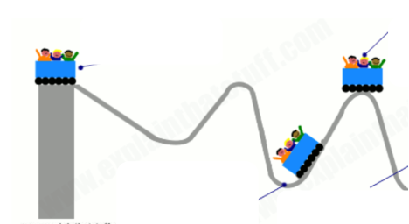
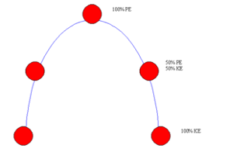
Entry Ticket

Slide 2
Engineering and Design
What do engineers do?

Slide 3
Engineers
Mechanical engineer
Civil engineer
Electrical engineer
Software engineer
Environmental engineer
Aerospace engineer
So many to choose from!

Slide 4

Today: You are Mechanical Engineers!
Your TEAM will build a spool racer using your knowledge of elastic potential energy and kinetic energy..

Slide 5
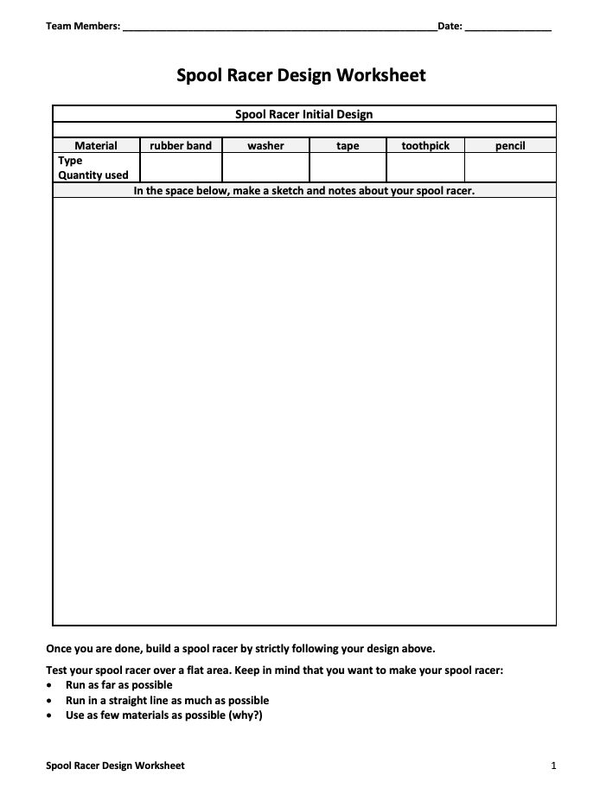
THEN...
Your TEAM will draw a blueprint of your design

Slide 6
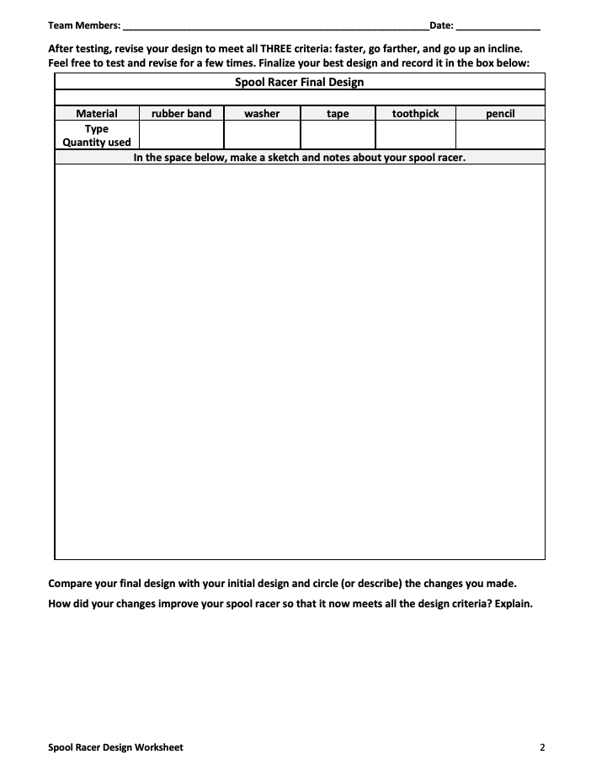
THEN...
Your TEAM will think about how to change your design to meet THREE Criteria:
Go faster
Go a longer distance
Go the longest distance up an incline
Make design changes and decide on a FINAL DESIGN--draw the BLUEPRINT

Slide 7
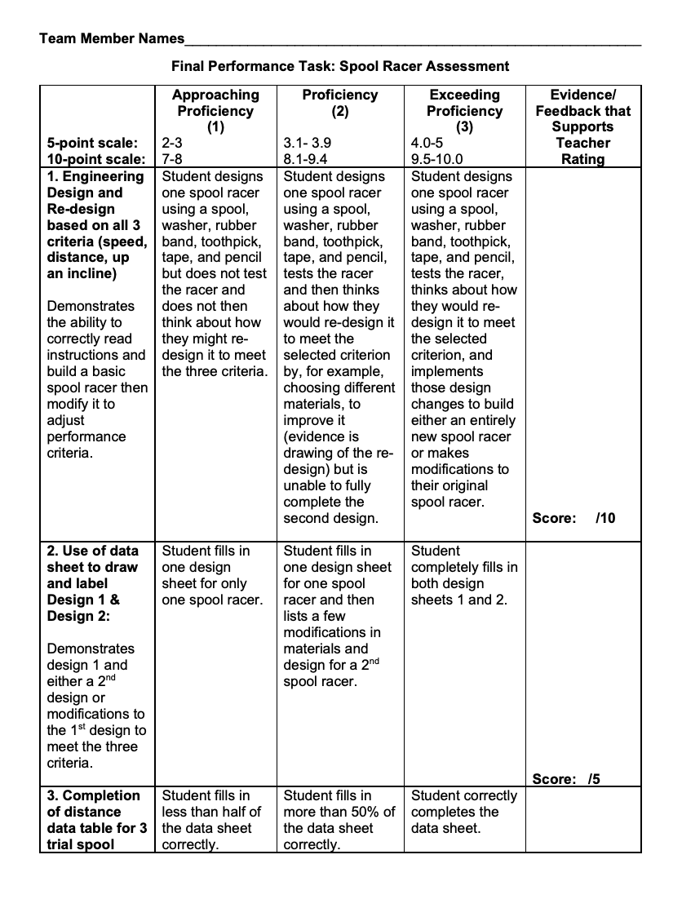
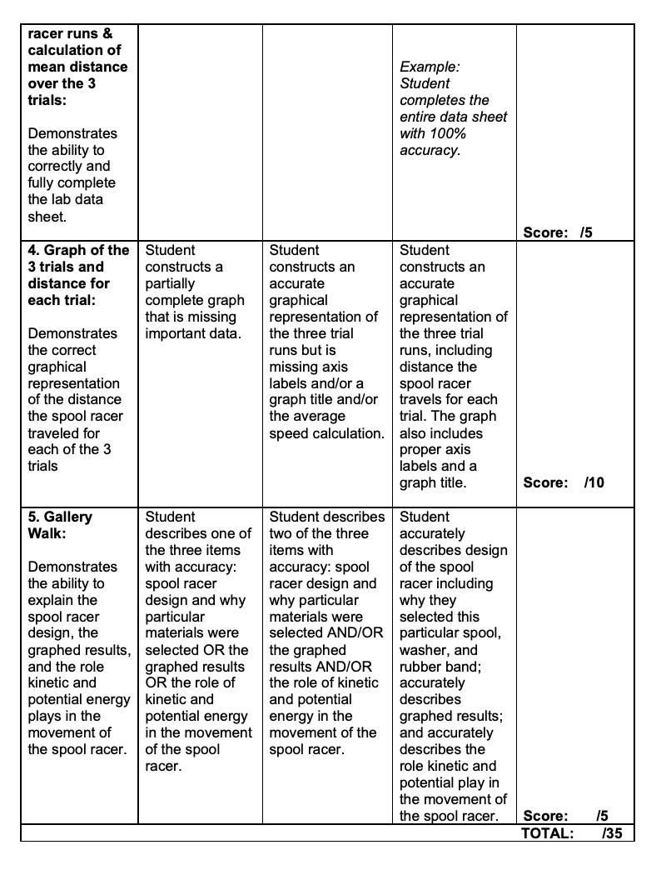
TEAM RUBRIC!

Slide 8
CLEAN UP & place your FINAL spool racer into a labeled zip-loc bag! On Monday we RACE!

